Slide 1



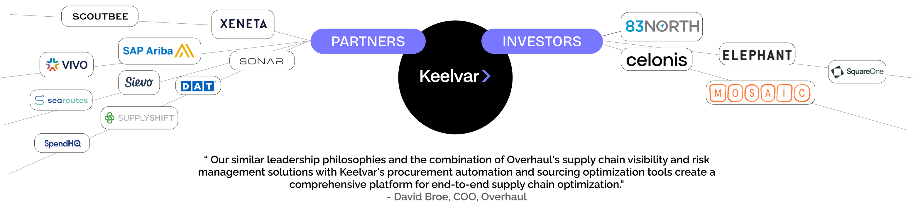
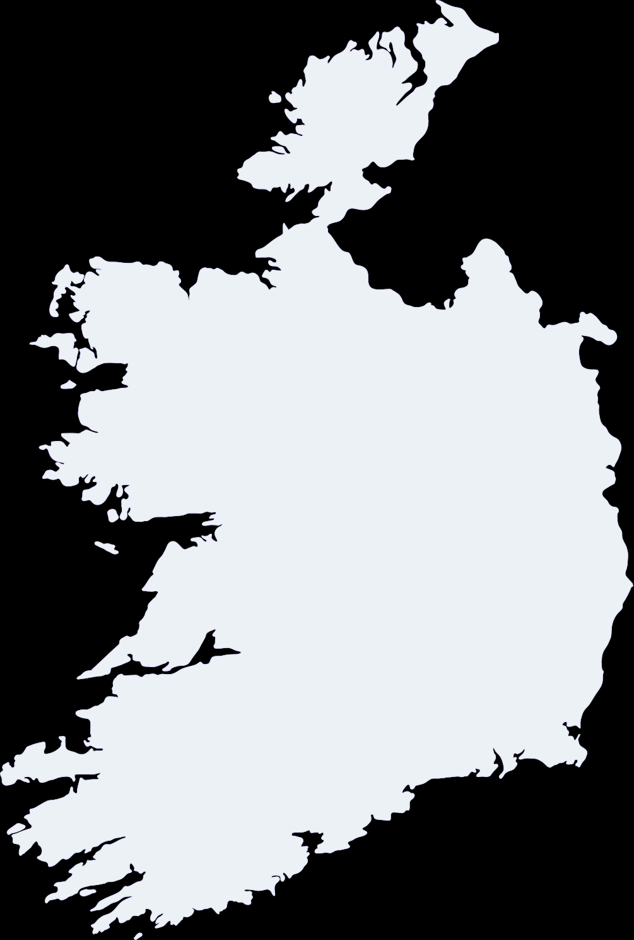


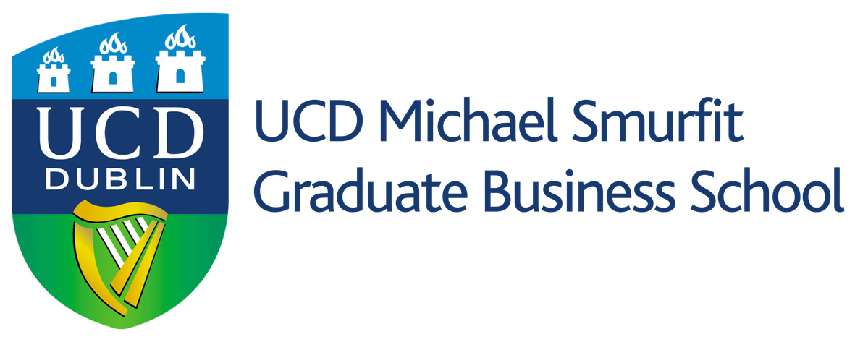

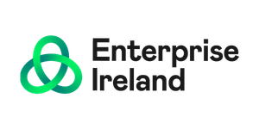
Ireland, and specifically Cork, provided the perfect 'Goldilocks' environment: world-class AI research from UCC combined with a gritty, entrepreneurial spirit that allowed us to build global Sourcing Bots that actually work in the real world.
- CEO of Keelvar, Alan Holland
Impact on Ireland
HOW THEIR AI WORKS
Strengthens Ireland’s image as a deep‑tech, AI innovation hub.
Adds a high‑growth Irish‑owned player to the “Silicon Docks” story.
Lower logistics and sourcing costs make Irish exports more competitive.
Success and funding help grow Ireland’s AI startup and investment ecosystem.
TIMELINE
Demand
Data ingestion
2012
AI‑assisted event setup
UCC spin-out . Enterprise Ireland ICT Commercialisation Award.
2013
Supplier bids
Key Insights- Proven Outcomes
Wins Cork Chamber of Commerce/Vodafone Emerging Company of the Year (Small Category).
Heavy‑equipment maker scaled sourcing events by 1,620% YoY.
Beverage giant saved 1,575 workdays across 175 events.
Consumer goods firm now manages $228M/month in spend (up from $4M).
Ingredients producer gained 26% savings; healthcare tech cut time‑to‑bid by 90%.
Electronics manufacturer achieved 649x ROI; Fortune 500 F&B got 8% price compression and minutes‑level analysis.
Overall, 85% of sourcing is automated, with some events done in <15 minutes
2018
AI scenario analysis
Named Gartner Cool Vendor in Procurement and Sourcing Technology
2019
Recommended award
Deploys world's first Sourcing Bots for clients like Siemens.Wins IT@Cork Smart Technology Innovation Award. Wins
2020
Wins CPO Honors Innovative Solution of the Year. Finalists: 2, Recognitions:1
2021
Wins IT@Cork/Kerry SciTech Tech Scale-Up of the Year. Wins Deloitte Technology Fast 50 Ireland
2024
Named to Spend Matters 50 to Watch and ProcureTech100 lists.
2025
Launches Kai, agentic AI orchestrator for natural language sourcing
Demand

